Slide 1
Exploring the World of Business and Economics

Slide 2
Learning Objectives
Discuss what you must do to be successful in the world of business.
Define business and identify potential risks and rewards.
Define economics and describe two types of economic systems: capitalism and command economy.
Identify the ways to measure economic performance.
Examine the different phases in the typical business cycle
Outline the four types of competition.
Summarize the factors that affect the business environment and the challenges that American businesses will encounter in the future.

Slide 3
Introduction
Free enterprise
  Individuals are free to decide what to produce, how to produce it, and at what price to sell it

Slide 4
Your Future in the Changing
World of Business
What does it take to succeed in business?
  Have a dream—know what you want
  Adapt to changes in the environment—work hard to turn your dreams into reality

Slide 5
Why Study Business? (cont’d)
For help in choosing a career
To be a successful employee
To improve your management skills
To start your own business
To become a better informed consumer
and investor

Slide 6
Tips for Studying Business
Prepare before you go to class.
Read the chapter.
Underline or highlight important concepts.
Take notes.
Apply the concepts.
Practice critical thinking.
Prepare for exams.

Slide 7
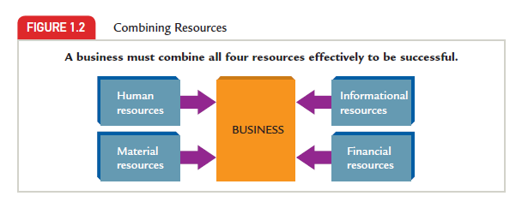
What Is Business?
The organized effort of individuals to produce and sell, for a profit, the goods and services that satisfy society’s needs

Slide 8
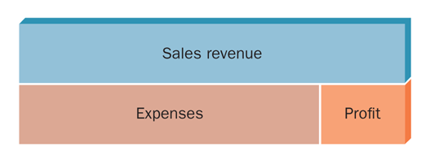
The Relationship Between Sales
Revenue and Profit
Profit is what remains after all business expenses have been deducted from sales revenue. A loss (negative profit) results when
a firm’s expenses are greater than its revenues.
FIGURE 1-3

Slide 9
Types of Economic Systems
Economics
  The study of how wealth (anything of value) is created and distributed
Microeconomics
  The study of the decisions made by individuals and businesses
Macroeconomics
  The study of the national economy and the global economy
Economy
  The system through which a society creates and distributes wealth

Slide 10
Types of Economic Systems (cont’d)
Factors of production
  Land and natural resources
  Labor
  Capital
  Entrepreneurship
Entrepreneur
  A person who risks time, effort, and money to start and operate a business

Slide 11
Types of Economic Systems (cont’d)
Differences in economic systems
  How they answer the four basic economic questions
    What goods and services will be produced?
    How will they be produced?
    For whom will they be produced?
    Who owns and controls the major factors
    of production?

Slide 12
Types of Economic Systems (cont’d)
Capitalism
  An economic system in which individuals own and operate the majority of businesses that provide goods and services
  Derived from Adam Smith’s laissez-faire capitalism in which a society’s best interests are served by individuals pursuing their own self-interest
    Creation of wealth is the concern of private individuals
    Resources used to create wealth must be privately owned
    Economic freedom ensures the existence of a free market economy
      Businesses and individuals decide what to produce and buy; the market determines quantities sold and prices
    Limited role of government

Slide 13
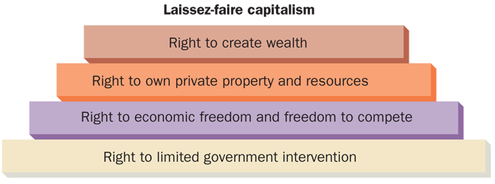
Basic Assumptions for Adam Smith’s
Laissez-Faire Capitalism
FIGURE 1-4

Slide 14
Types of Economic Systems (cont’d)
Capitalism in the United States
  Mixed economy with elements of capitalism and socialism
  Households
    Consumers of goods and services
    Resource owners of some factors of production
  Businesses
    Produce goods and services to exchange for revenues (money)
    Use revenues to purchase factors of production
  Governments
    In exchange for taxes, governments provide public services that would not be provided by business or would be produced only for those who could afford them

Slide 15
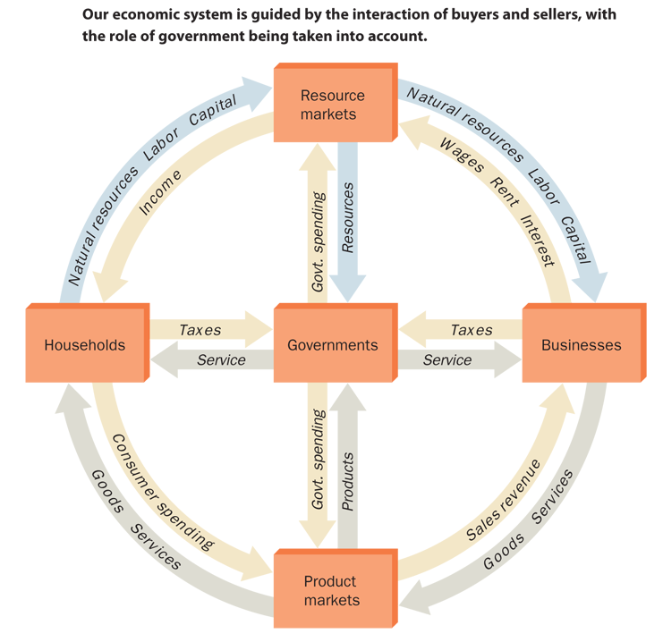
The Circular Flow in Our Mixed Economy
FIGURE 1-5

Slide 16
Types of Economic Systems (cont’d)
Command economies
  Economic systems in which the government decides what will be produced, how it will be produced, who gets what is produced, and who owns and controls the major factors of production
  Socialism
    Key industries (e.g., transportation, utilities, and banking) are owned and controlled by the government
    Small-scale private businesses may be permitted and workers may choose their own occupations
    Production is based on national goals, and distribution is controlled by the state
    Intent is the equitable distribution of income, elimination of poverty, social services to all who need them, elimination of the economic waste of capitalistic competition

Slide 17
Types of Economic Systems (cont’d)
Command economies (cont’d)
  Communism
    All factors of production are owned and controlled by the government as proxy for ownership by all citizens
    Production is based on centralized state planning to meet the needs of the state and not necessarily the needs of its citizens
    The state dictates occupational choices and sets prices and wages
    Intent is to create Karl Marx’s concept of a classless society where all contribute according to their ability and receive benefits according to their needs.

Slide 18
Measuring Economic Performance
Productivity
  The average level of output per worker per hour
Economic indicators
  Gross domestic product (GDP)
    The total value of all goods and services produced by all people within the boundaries of a country during a one-year period

Slide 19
Measuring Economic Performance (cont’d)
Economic indicators (cont’d)
  Inflation
    A general rise in the level of prices
  Deflation
    A general decrease in the level of prices

Slide 20
Measuring Economic Performance (cont’d)
Economic indicators (cont’d)
  Unemployment rate
    The percentage of a nation’s labor force unemployed at any time
  Consumer price index (CPI)
    A monthly index that measures the changes in prices of a fixed basket of goods purchased by a typical consumer in an urban area
  Producer price index (PPI)
    An index that measures prices that producers receive for their finished goods

Slide 21
Common Measures Used to Evaluate a Nation’s Economic Health
Balance of trade
  The total value of a nation’s exports minus the total value of its imports over a specific period of time
Bank credit
  A statistic that measures the lending activity of commercial financial institutions
Corporate profits
  The total amount of profits made by corporations over selected time periods

Slide 22
Common Measures Used to Evaluate a Nation’s Economic Health (cont’d)
Inflation rate
  An economic statistic that tracks the increase in prices of goods and services over a period of time; usually calculated on a monthly or annual basis
National income
  The total income earned by various segments of the population, including employees, self-employed individuals, corporations, and other types of income

Slide 23
Common Measures Used to Evaluate a Nation’s Economic Health (cont’d)
New housing starts
  The total number of new homes started during a specific time period
Prime interest rate
  The lowest interest rate that banks charge their most creditworthy customers

Slide 24
The Business Cycle
The recurrence of periods of growth and recession in a nation’s economic activity
  Recession
    Two or more consecutive three-month periods of decline in a country’s gross domestic product
  Depression
    A severe recession that lasts longer than a recession
  Monetary policies
    Federal Reserve decisions that determine the size
    of the supply of money in the nation and the level
    of interest rates

Slide 25
The Business Cycle (cont’d)
Fiscal policy
  Government influence on the amount of
  savings and expenditures; accomplished by altering the tax structure and by changing the levels of government spending
Federal deficit
  A shortfall created when the federal government spends more in a fiscal year than it receives
National debt
  The total of all federal deficits

Slide 26
Types of Competition
Rivalry among businesses for sales
to potential customers
Perfect (or pure) competition
  The market situation in which there are many buyers and sellers of a product, and no single buyer or seller is powerful enough to affect the price of that product
    Supply: The quantity of a product that producers are willing to sell at each of various prices
    Demand: The quantity of a product that buyers are willing to purchase at each of various prices
    Market Price (Equilibrium): The price at which the quantity demanded is exactly equal to the quantity supplied

Slide 27
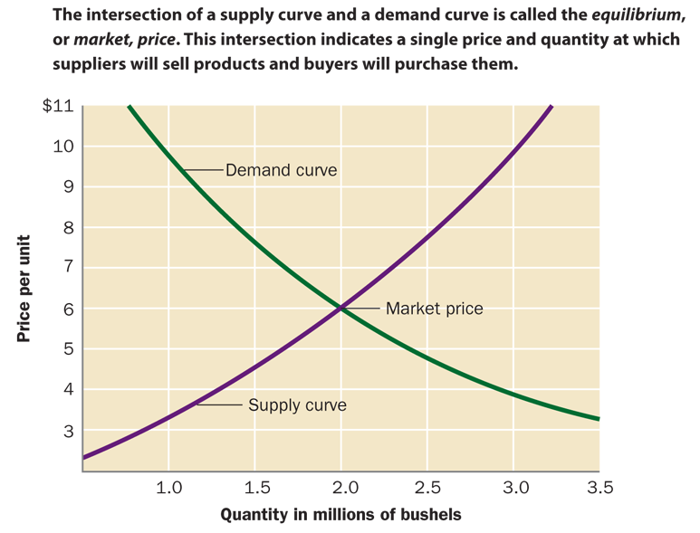
Supply Curve and Demand Curve
FIGURE 1-7

Slide 28
Types of Competition (cont’d)
Monopolistic competition
  A market situation where there are many buyers along with a relatively larger number of sellers who differentiate their products from the products of competitors
  Product differentiation
    The process of developing and promoting differences between one’s products and all similar products

Slide 29
Types of Competition (cont’d)
Oligopoly
  A market situation (or industry) in which there are few sellers
    E.g., automobile manufacturers, car rental agencies,
    and farm implement industries
  Sizable investments are required to enter into
  the market
  Each seller has considerable control over price
  The market actions of one seller can have a strong effect on competitors

Slide 30
Types of Competition (cont’d)
Monopoly
  A market (or industry) with only one seller
  Natural monopoly
    An industry requiring huge investments in capital and within which duplication of facilities would be wasteful and thus not in the public interest
  Legal monopoly (limited monopoly)
    A monopoly created when a government entity issues a franchise, license, copyright, patent, or trademark protecting the owners of written materials, ideas, or product brands from unauthorized use by competitors

Slide 31
American Business Today
Standard of living
  A loose, subjective measure of how well off an individual or a society is mainly in terms of want satisfaction through goods and services
Early business development
  Barter system
    A system of exchange in which goods or services are traded directly for other goods and/or services without using money
  Domestic system
    A method of manufacturing in which an entrepreneur distributes raw materials to various homes, where families process them into finished goods to be offered for sale by
    the merchant entrepreneur

Slide 32
American Business Today (cont’d)
Early Business Development (cont’d)
  Factory system
    A system of manufacturing in which all the materials, machinery, and workers required to manufacture a product are assembled in one place
  Specialization
    The separation of a manufacturing process into distinct tasks and the assignment of the different tasks to different individuals

Slide 33
American Business Today (cont’d)
Business Development in the 1900s
  Rapid growth of large industries (automobiles, steel, oil, chemical) and the mass production of consumer goods
  The Roaring Twenties ended with the 1929 stock market crash
  Government intervention became necessary to get the economy moving again

Slide 34
American Business Today (cont’d)
Business Development in the 1900s (cont’d)
  Major events that shaped the nation’s economy between 1940 and 2000 include:
    WWII, the Korean War, and the Viet Nam War
    Rapid economic growth and higher standard of living during the 1950s and 1960s
    The social responsibility movement during the 1960s
    A shortage of crude oil and higher prices for most goods in the mid-1970s
    High inflation, high interest rates, and reduced business profits during the early 1980s
    Sustained economic growth in the 1990s

Slide 35
American Business Today (cont’d)
Business Development in the 1900s (cont’d)
  E-Business—the organized effort of individuals to produce and sell through the Internet, for a profit, products and services that satisfy society’s needs--became an accepted method of conducting business
  In the last part of the 1900s, a large number of business failures and declining stock values suggested larger economic problems to come

Slide 36
American Business Today (cont’d)
A New Century: 2000 and Beyond
  Technology becomes affordable
  Growth of service businesses
    Service economy—an economy in which more effort is devoted to the production of services than to the production of goods
  Although many economic indicators are strong, there is a feeling of pessimism, a large number of business failures, high unemployment, and terrorist threats

Slide 37
American Business Today (cont’d)
The Current Business Environment
  The competitive, global, technological, and economic environments affect business today

